Slide 1

LESSINGER
RACING FOIL 30
LESSINGER
RACING FOIL 30
Luxury hydrofoil performance
for the next generation of coastal life.
CONFIDENTIAL INVESTOR PRESENTATION
€1.8M raise • 30% equity • August 2026
STÉPHANE SINGER
DESIGNED TO FLY

Slide 2
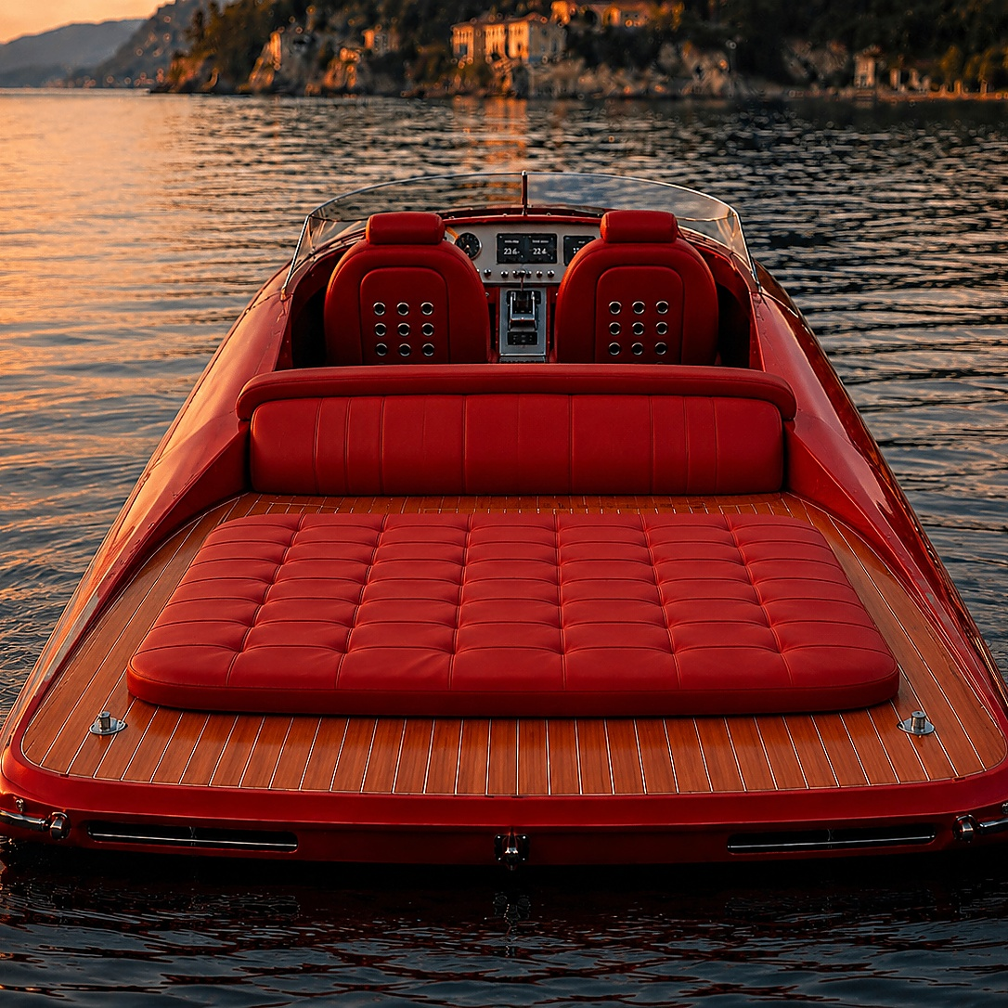
01 • THE FOUNDER
02
A founder-led platform for a new luxury category
Stéphane Singer
Founder & Managing Director
THE ASK
A product vision shaped by
high-performance yachting,
luxury automotive design and
naval innovation.
€1.8M
for 30% equity
€4.2M
PERFORMANCE
Race-bred thinking applied to quiet, efficient coastal mobility.
PRE-MONEY
€6.0M
POST-MONEY
LUXURY
A tactile, bespoke product language — from cockpit to teak deck.
EXECUTION
A clear path from prototype validation to selective production.
FOUNDER-LED / ASSET-LIGHT
STÉPHANE SINGER

Slide 3

02 • DESIGN LANGUAGE
03
A cockpit and sunbed engineered as a private members’ club
Retro-futurist,
not retro.
Dual navigation displays. Carbon / leather wheel.
A low-slung helm, wrapped in tactile materials.
MIDNIGHT BLACK
Crimson Red
MONACO BLUE
Camel
PURE WHITE
Titanium Grey
ONE HULL. THREE SIGNATURES.
GARANCE RED LEATHER • TEAK DECK • CARBON DETAILING

Slide 4
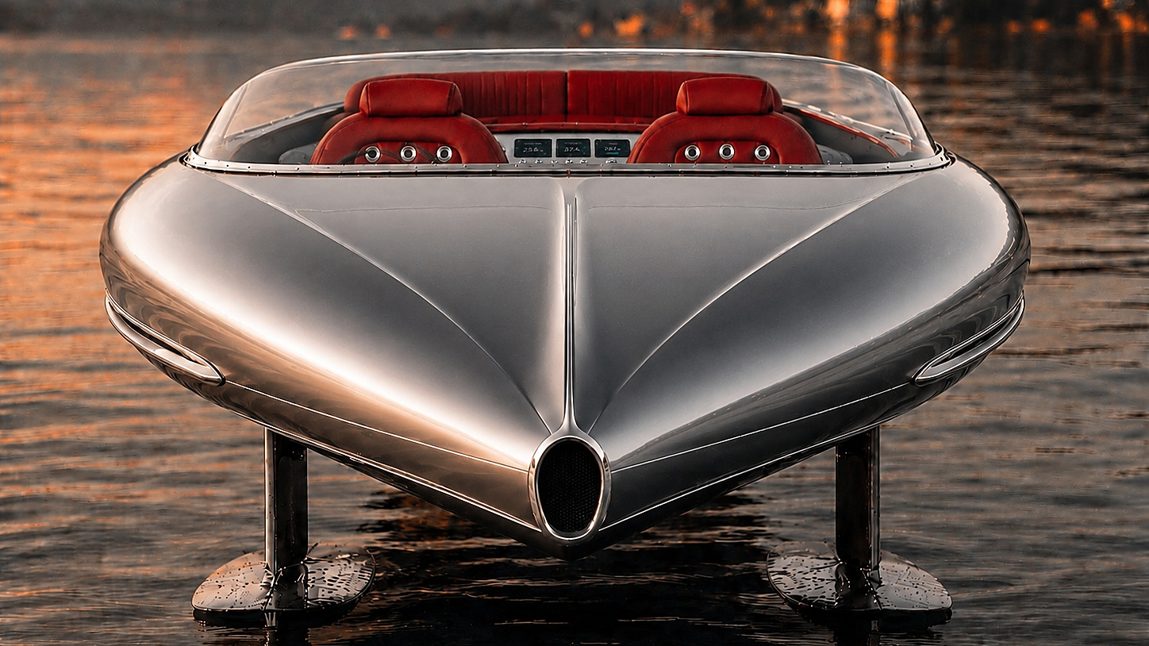
03 • PRODUCT ARCHITECTURE
04
30 feet of composite drama — tuned around the foil flight envelope
SIDE PROFILE / SYSTEMS MAP
COCKPIT
SUNBED
automatic foiling @ 16 kn
DESIGN TARGETS
5–6 passengers | 8–8.5 m LOA
1.7–2.0 t target mass | Carbon / glass composite
INVERSE T-FOIL
INVERSE T-FOIL
TARGET PLATFORM
Validation via CFD + prototype

Slide 5
04 • HYDRODYNAMICS
05
The sensation of flight, made legible in engineering terms
INVERSE T-FOILS / FLIGHT CONTROL
16 kn
automatic foiling threshold
gyroscopic
flight stabilization
lift
+ stability
−80%
CARBON COMPOSITE HULL
drag reduction target
WATERLINE
T-FOILS
carbon inverse geometry
Engineering targets — subject to CFD, tank testing and sea trials.

Slide 6
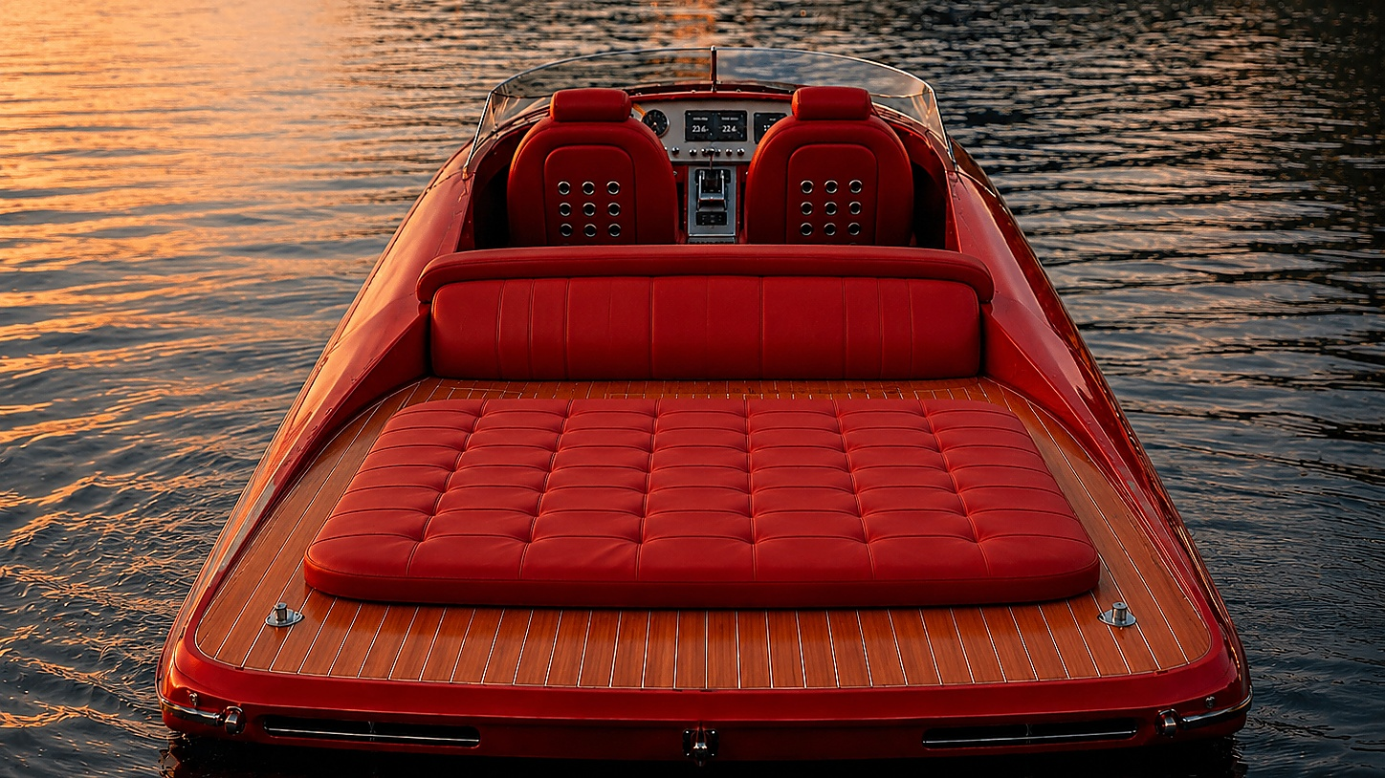
05 • PROPULSION
06
A compact incisor pod with a contrarotating heart
INCISOR POD / PROPULSION LOGIC
THRUST
INCISOR POD
dual contra-rotating propellers
600 hp eq.
electric / hybrid powertrain
PASSIVE COOLING
direct water cooling loop
>45–50 kn
top speed target
High-performance targets; final architecture to be validated by prototype.

Slide 7
06 • BUSINESS PLAN
07
A premium unit economics story, anchored by scarcity and spectacle
€850k–1.2M
3 units
30%
€6.0M
target unit price
break-even target
equity offered
post-money valuation
INVESTMENT THESIS
PRODUCTION ROADMAP
1
A new luxury category: a 30-ft hydrofoil runabout that performs like a machine and lives like a yacht.
Y1
Y2
Y3
2
High gross-ticket product with bespoke upside, selective distribution and a visible founder story.
2 units
6 units
12 units
3
Raise funds the proof points: Hull #1, tooling, market presence and defensible IP.
Scale after proof — not before.

Slide 8
07 • USE OF FUNDS
08
€1.8M to move from beautiful concept to credible first delivery
ALLOCATION OF CAPITAL
MILESTONES UNLOCKED
40%
01
Prototype
running hull + foil validation
Hull #1 prototype
30%
02
Tooling
repeatable composite pathway
Molds & tooling
20%
03
Market
Monaco / Dubai visibility
Marketing • Monaco & Dubai
04
IP
system know-how + brand moat
10%
IP & working capital
Capital is sequenced against proof, not vanity.

Slide 9

08 • EXPANSION
09
A two-coast launch strategy for the world’s most visible water
SELECTIVE MARKET ENTRY
UAE
Dubai • Abu Dhabi
Showroom, demo fleet, yacht ecosystem
FRENCH RIVIERA
Monaco • Saint-Tropez • Cannes
Influence, references, concierge sales
Launch where the product is
seen, shared and desired.
Launch where the product is
seen, shared and desired.
DEMO → REFERENCE → SCALE
DEMO → REFERENCE → SCALE

Slide 10
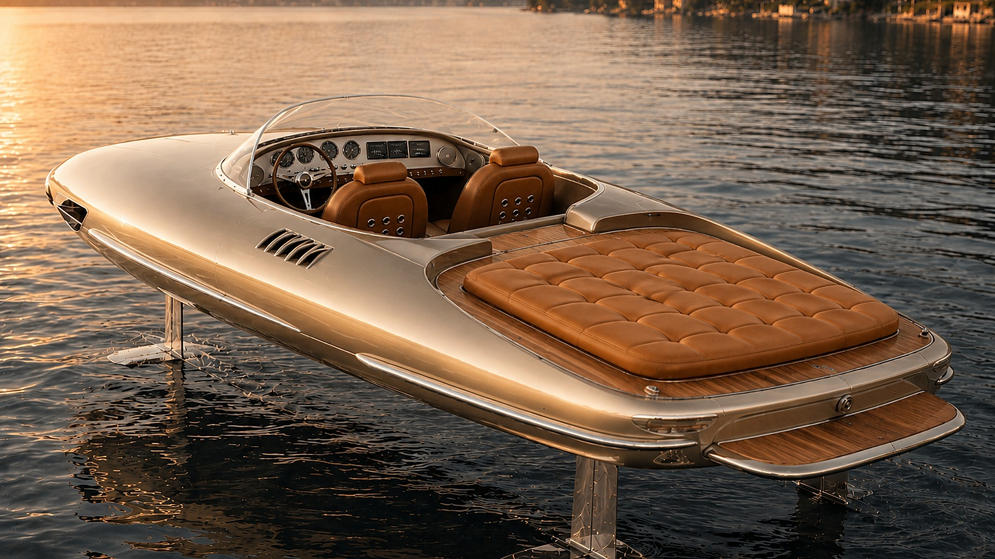
LESSINGER
THE NEXT CHAPTER
Build the boat
people remember.
Lessinger Racing Foil 30 is not a faster boat.
It is a new way to arrive.
€1.8M • 30% • CONFIDENTIAL
Stéphane Singer | Founder & Managing Director

